Slide 1
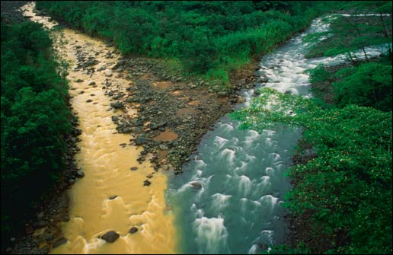
Two Streams Of Bible Transmission
Antioch
Alexandria

Slide 2
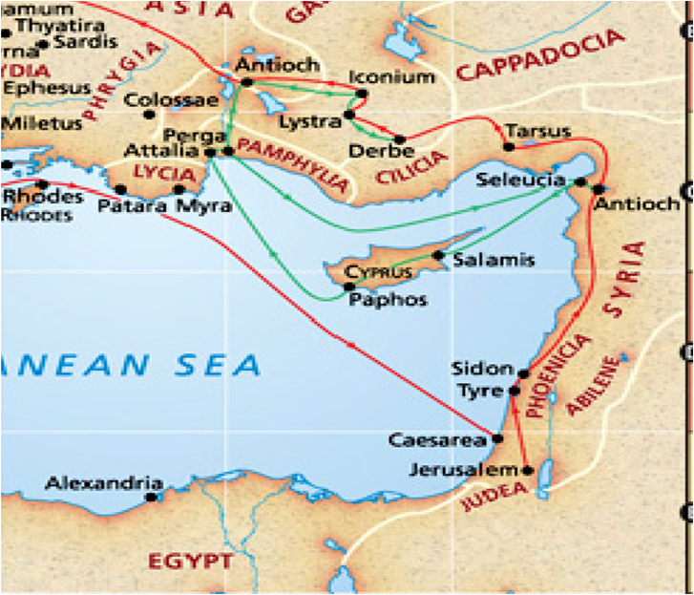

Antioch
Alexandria

Slide 3
Alexandria
Antioch
Center of Christianity
Center of Paganism
Pure Stream of the Received Text
Polluted Stream of Modern Versions
95% Majority Texts
5% Minority

Slide 4
Alexandria
Antioch
Wycliffe Bible 1380
Origen of Alexandria 240AD
Erasmus Published 1st Greek New Testament based on received text 1516
Constantine, the 1st pope, has Eucebius make 50 bibles in 331AD
Tyndale New Testament 1525, 1st Printed New Testament in English
Jerome's Latin Vulgate, 382
Coverdale 1535, Coverdale Bible, 1st Printed Bible in English
Vaticanus , Sinaiticus, two of Constantine’s Catholic bible’s

Slide 5
Alexandria
Antioch
Great Bible 1539
Wescott & Hort, produced new Greek text in 1875
Geneva Bible 1560
New Modern Versions
Bishops Bible 1568
NIV,
1973, 1978, 1984
KJV 1611
NIV,
Gender Neutral Version
2011

Slide 6
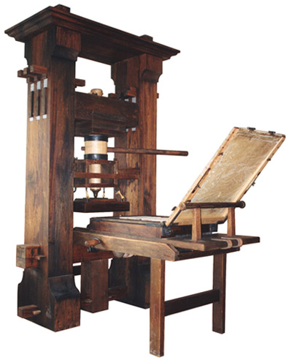
Gutenberg Printing Press invented in the mid 1400’s

Slide 7
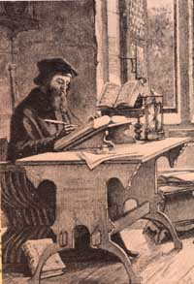
Wycliffe Bible
Wycliffe records in his preface that he translated from the vulgar Latin: translated into English from the vulgar Latin, by John Wycliffe, D.D. Rector of Lutterworth 1380.
Vulgar Latin referred to the common Latin text that is in perfect harmony with the Received Text and the KJV.
Wycliffe did not use the corrupt Latin Vulgate
Vulgar Latin does not mean Latin Vulgate

Slide 8
Latin Vulgate
Jerome was commissioned by Pope Damasus I to produce a Latin Bible for the Roman Catholic Church in AD 382, this Bible is referred to as Jerome’s Latin Vulgate.
Jerome admitted to altering the text in his preface to the Latin Vulgate.
Jerome’s Vulgate is the source of the corrupt Catholic Douay version of the Bible produced in 1609.

Slide 9
“These two great fourth-century uncials agree rather closely with the third century papyri. This provides us with a more accurate Greek text of the New Testament than that found in the Textus Receptus, which is based primarily on late minuscules. We should be grateful to God for making these early manuscripts available to us as the basis for an up-to-date, contemporary translation of an ancient text.”– Translator Ralph Earle.
- From The NIV: The Making of a Contemporary Translation, Edited by Kenneth Barker, pp 56,57 online ed.

Slide 10
Blasphemy! Isaiah 14:12
KJV
NIV
How art thou fallen from heaven, O Lucifer, son of the morning! how art thou cut down to the ground, which didst weaken the nations!
How you have fallen from heaven, morning star, son of the dawn! You have been cast down to the earth, you who once laid low the nations!

Slide 11
Confusion! Proverbs 26:10
KJV
NIV
The great God that formed all things both rewardeth the fool, and rewardeth transgressors.
Like an archer who wounds at random is he who hires a fool or who hires those who pass by.

Slide 12
Changes Anointing! Isaiah 10:27
KJV
NIV
And it shall come to pass in that day, that his burden shall be taken away from off thy shoulder, and his yoke from off thy neck, and the yoke shall be destroyed because of the anointing.
the yoke broken because you have grown fat.

Slide 13
Takes Out The Blood!? Colossians 1:14
KJV
NIV
In whom we have redemption Through His Blood, even the forgiveness of sins:
In whom we have redemption, the forgiveness of sins.
The NIV completely removes the blood of Jesus. The devil hates the Blood of Jesus. Does this look like an accurate translation of an ancient manuscript, or a deliberate attack on the pure Word of God?

Slide 14
Takes Out Fasting? Matthew 17:21
KJV
NIV
Howbeit this kind goeth not out but by prayer and fasting.
Omitted text?

Slide 15
Removes Jesus? Acts 8:37
KJV
NIV
And Philip said, If thou believest with all thine heart, thou mayest. And he answered and said, I believe that Jesus Christ is the Son of God.
Omitted text?

Slide 16
Deafness! Mark 7:16
KJV
NIV
If any man have ears to hear, let him hear.
Omitted text?

Slide 17
No Trinity? 1John 5:7
KJV
NIV
For there are three that bear record in heaven, the Father, the Word, and the Holy Ghost: and these three are one.
Omitted text?

